Slide 1
Production and Comparative Advantage
Steven Suranovic
George Washington University

Slide 2
Model Assumptions
Include all assumptions of the Pure Exchange model
Instead of an endowment, Smith and Jones must produce their apples and oranges
Their production capabilities for apple and oranges will differ
See the description below …

Slide 3
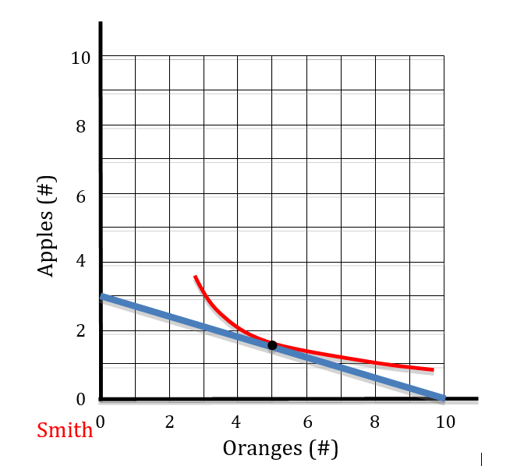
Smith’s Production Possibility Frontier
Smith is endowed with 1 hour of labor
He can produce 10 oranges in one hour
He can produce 3 apples in 1 hour

Slide 4
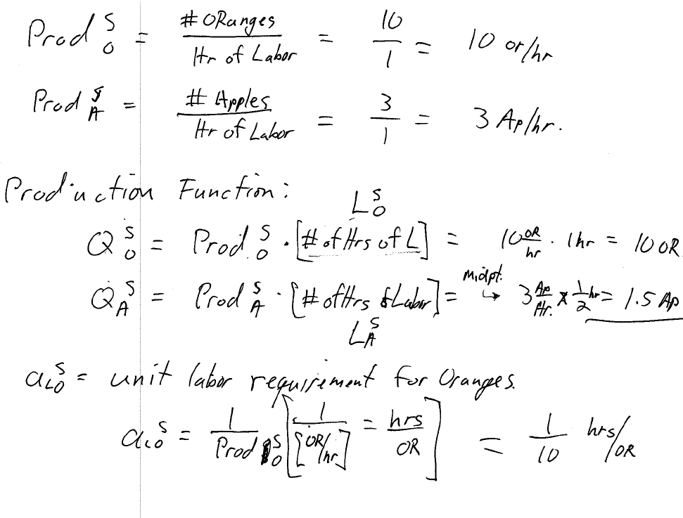

Slide 5
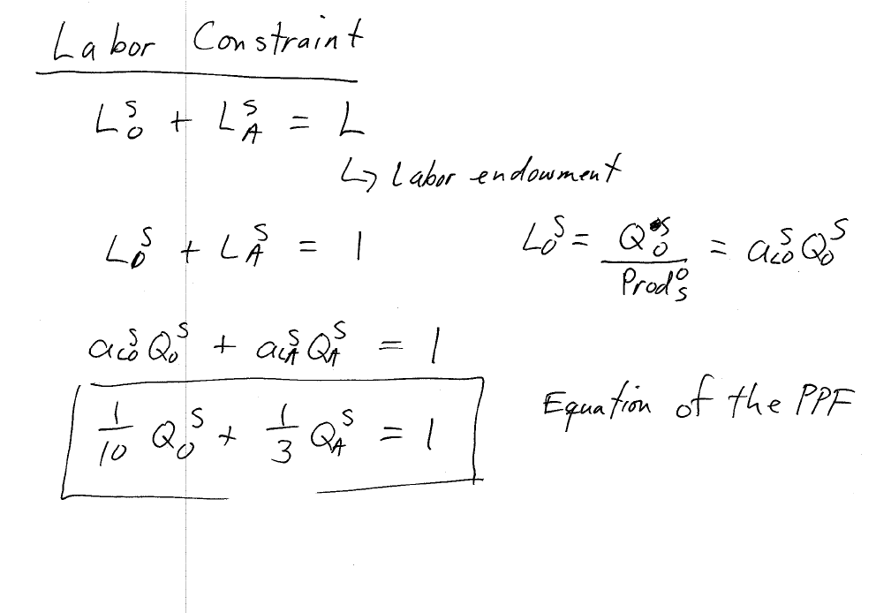

Slide 6
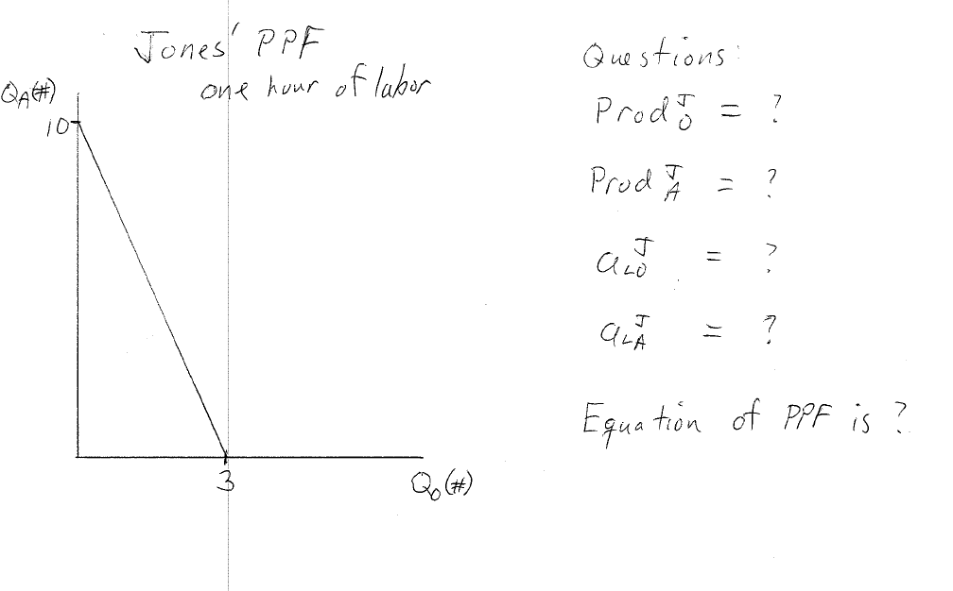
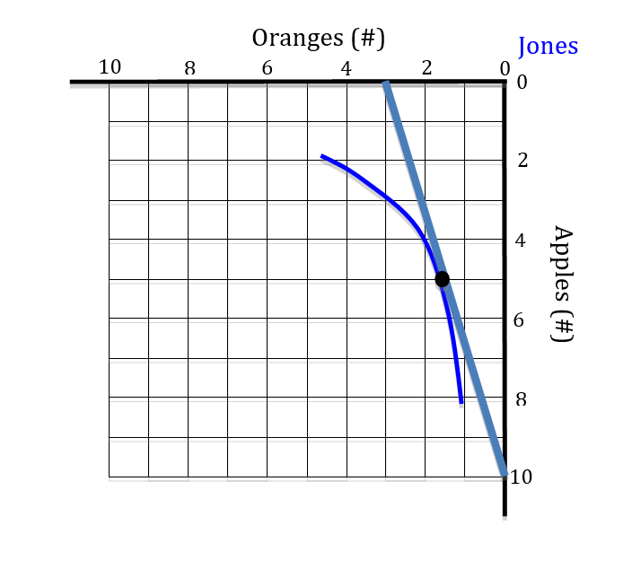

Slide 7
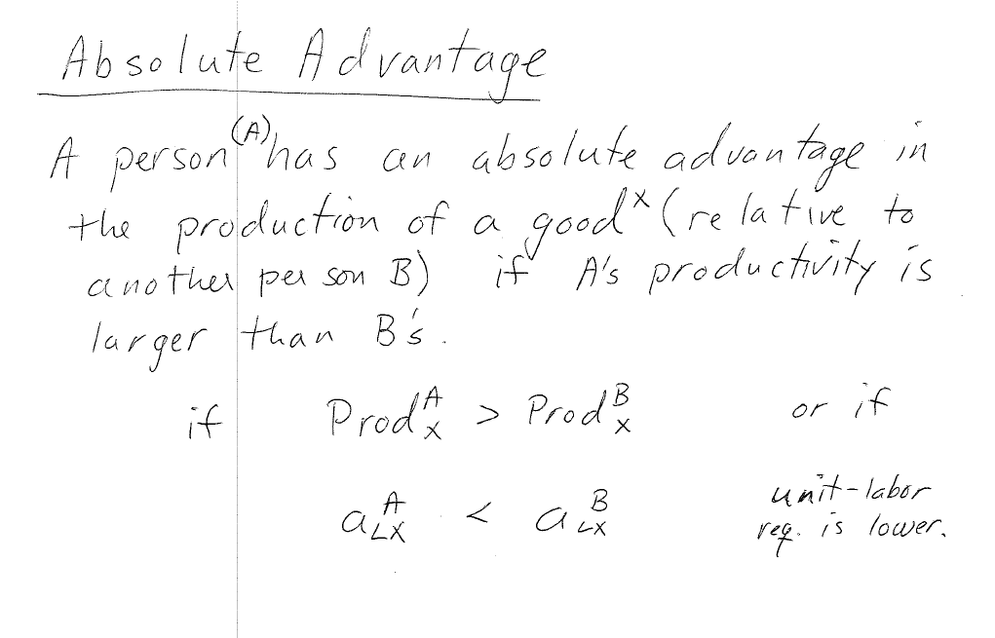

Slide 8
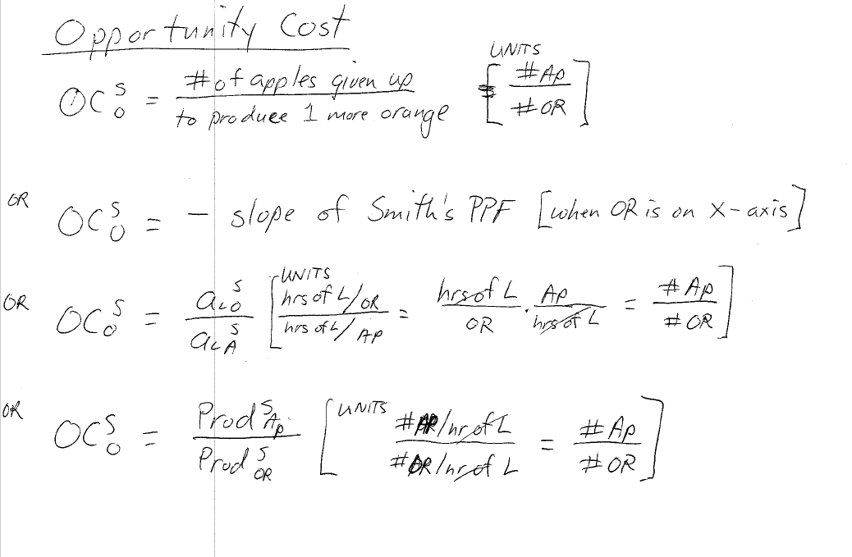

Slide 11
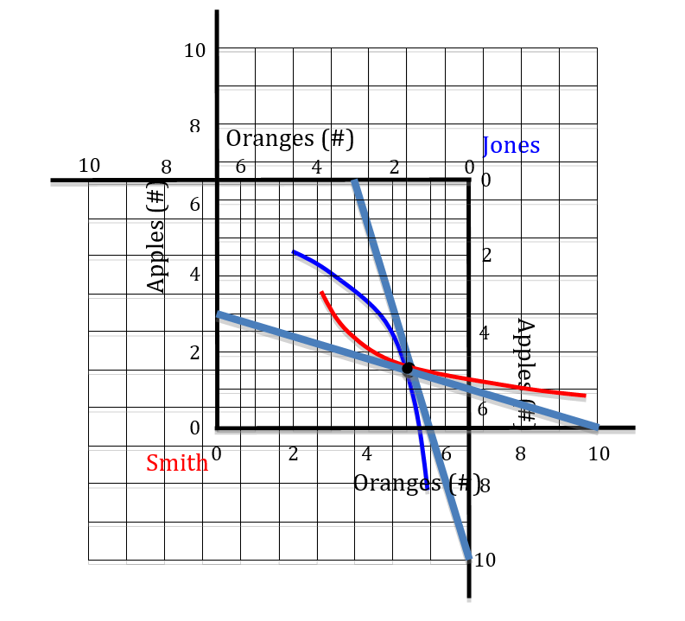
Autarky Production Edgeworth Box
Diagram assumes Smith and Jones come to a market after producing their autarky, utility-maximum, bundles.
EB (6.5 x 6.5 in size) is created by taking their autarky production points as their endowments.

Slide 12
Autarky Production Edgeworth Box
Because the two ICs form a lens → there are trades possible to increase utility for both.
The trading ToT value must lie between Smith’s Opp Cost of cheese (slope of Smith’s PPF) and Jones’ OC for cheese.
eg. 1 OR for 1 AP,
or 1.5 OR for 1.5 AP,
or 1.5 OR for 2 AP

Slide 13
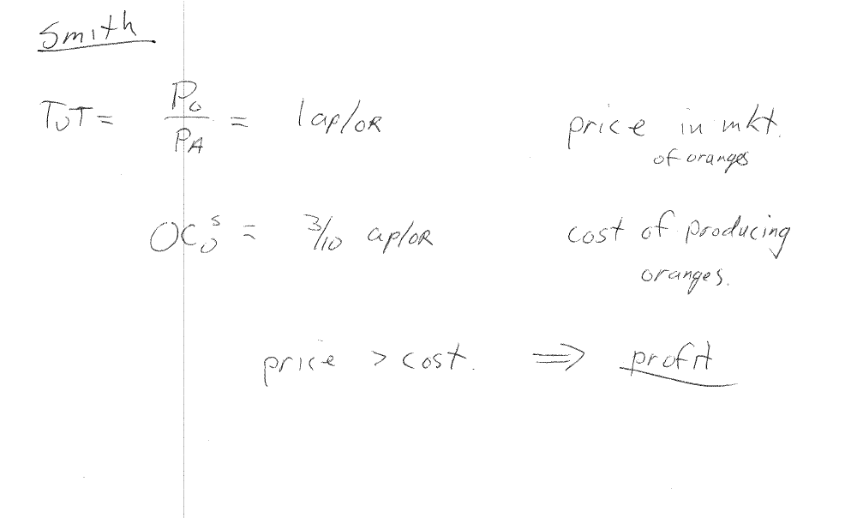

Slide 14
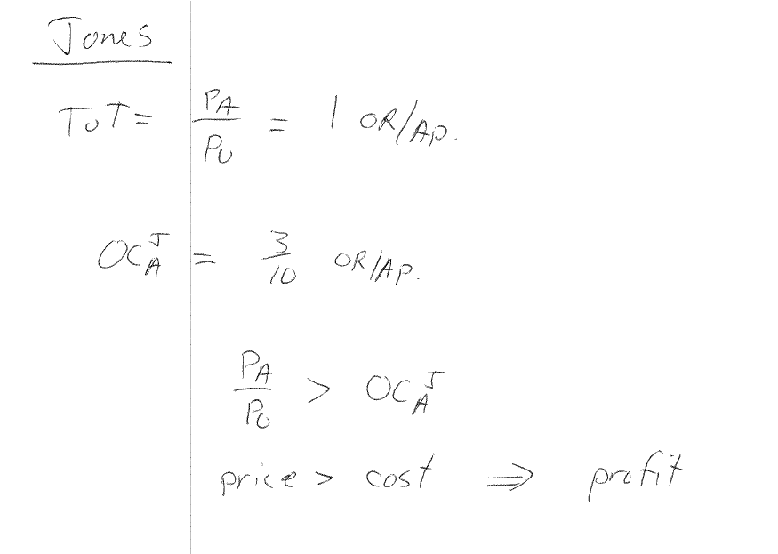

Slide 15
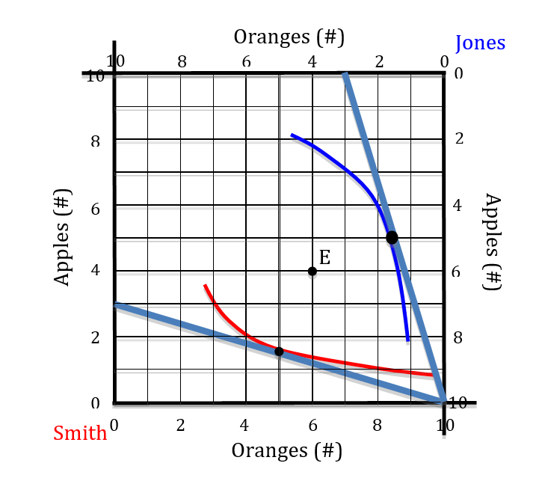
EB after Specialization in CA goods
Smith produces 10 oranges; Jones produces 10 apples
Specialization is inspired by desire for more profit/utility
EB is 10 x 10 and both traders’ utilities can rise substantially relative to autarky.
Increase in production efficiency because there is more of both goods available

Slide 16
EB after Specialization in CA goods
Because there are more of both goods with specialization, production efficiency increases.
Trade can occur to a point like E where the ToT = 1 Ap/Or
Note OCS < ToT < OCJ
A plausible ToT must satisfy above condition

Slide 17
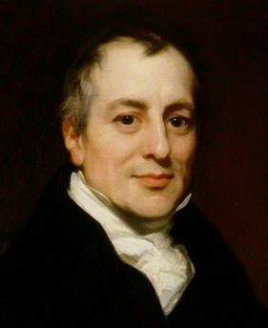
David Ricardo (1772-1823)
Discoverer/popularizer of the principle of Comparative Advantage
Our model of production and CA often called the Ricardian model.
“On the Principles of Political Economy and Taxation (1817)
Proponent of free trade

Slide 18
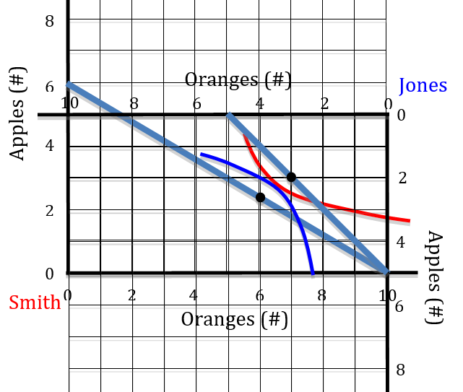
One person with no Absolute Advantage
Who has the absolute Adv in oranges? … in apples? Explain why.
What is each person’s Opp Cost? Include units.
Who has the CA in oranges? … in apples? Why?
Where is the specialization point?
What do the black dots on the PPFs represent?
What does the tangency of the two ICs represent?
What is a possible trading ToT?

Slide 19
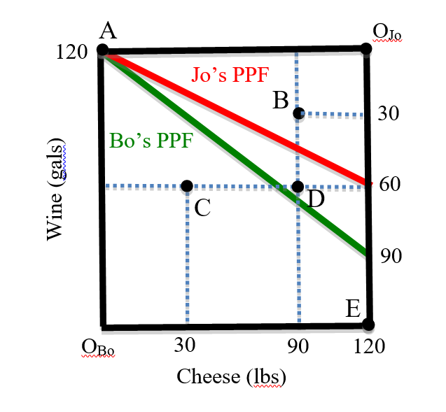
Examples from Problem Sets
This is an EB with production and specialization at A.
Diagram provides partial information .. To answer some questions requires making inferences
For example Bo’s productivity of cheese must be calculated using the info on the graph

Slide 20
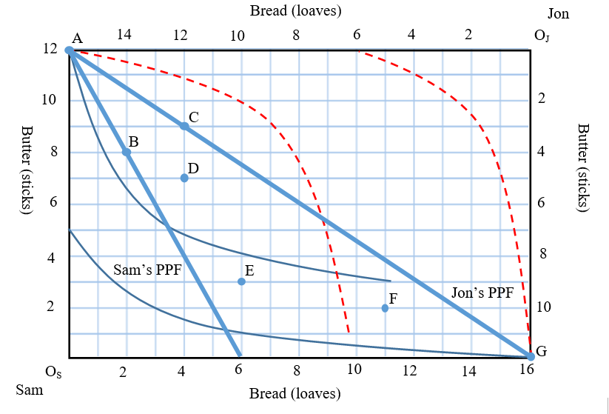
Examples from Problem Sets
This is an EB with production and specialization at A.
Diagram has PPFs and indifference curves drawn
Note whose origin is where. Note endpoints of each PPF, if shown
Note there are regions that are mutually beneficial that they would not choose

Slide 21
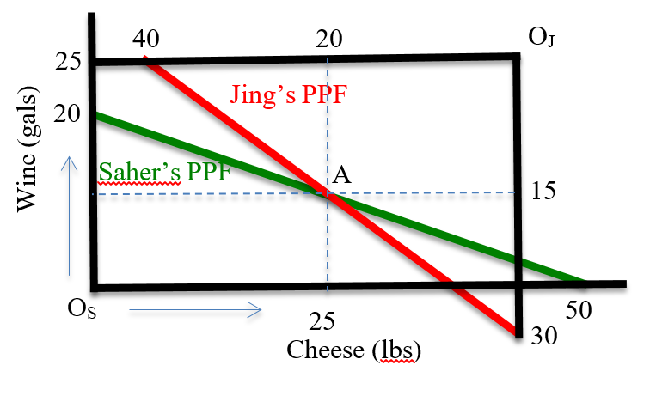
Examples from Problem Sets
This is an EB with production but no specialization at A (called diversification).
Note location of each person’s origin and PPF
Could you calculate the endpoints on the lower right if they weren’t listed?

